Slide 1
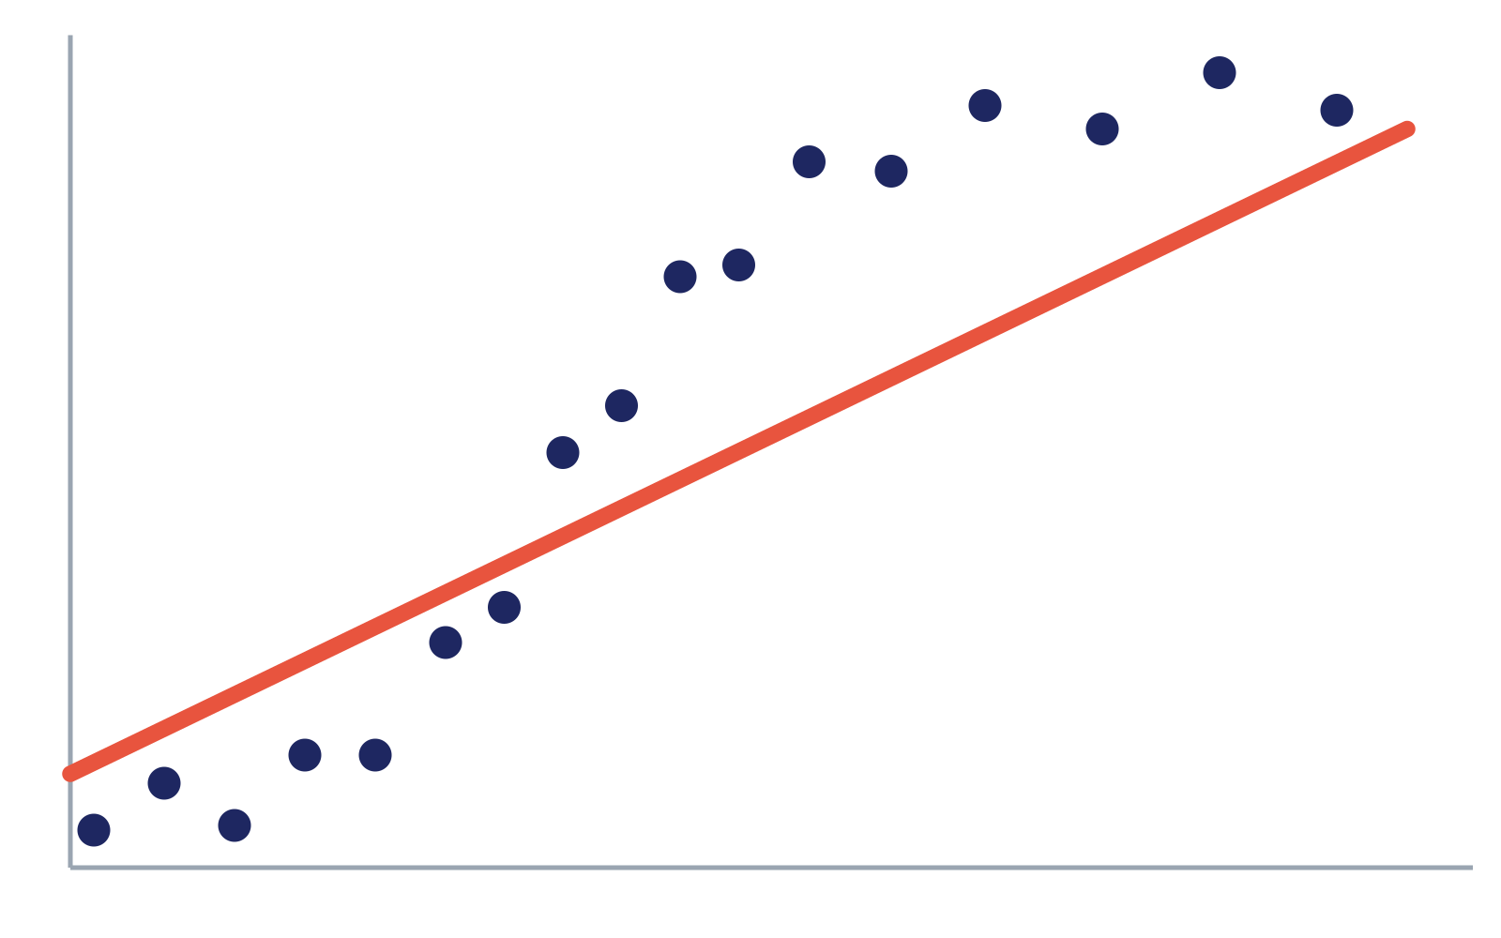
THE “TOO DUMB” PROBLEM
Underfitting
The model is too simple. It misses the main pattern.
WHAT HAPPENS
Bad predictions on practice data AND bad predictions on new data.
THE HISTORY TEST EXAMPLE
You only memorize “Everything happened in 1776.” You fail the practice test AND the real test — because you didn’t learn enough.
HOW TO FIX IT
Make the model more complex — add more features, or give it more training time.
The straight line is too stiff — it doesn’t follow the curve of the data, so it misses almost every dot.
Notes:
Underfitting: the model is too simple to capture the pattern. Fix by adding complexity.

Slide 2
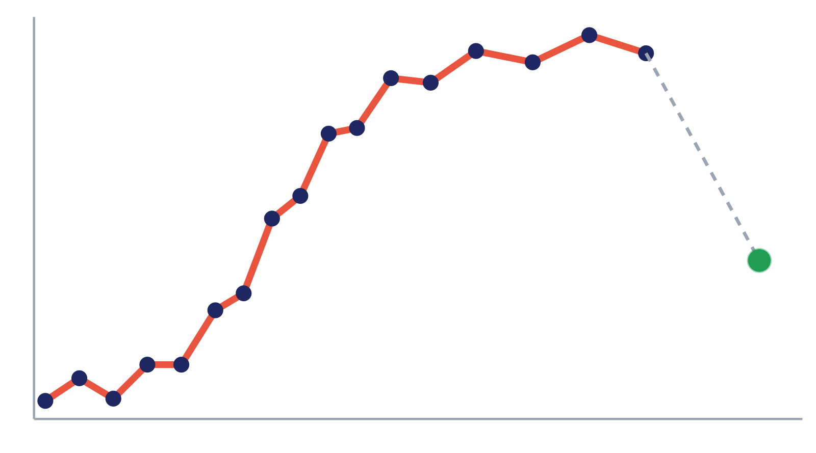
THE “CHEATING” PROBLEM
Overfitting
The model is too complex. It memorizes the noise, not the pattern.
WHAT HAPPENS
Perfect score on practice data, but fails miserably on new data.
THE HISTORY TEST EXAMPLE
You memorize the textbook word-for-word, including typos. You get 100% on the practice test, but fail the real test because the teacher rewords the questions.
HOW TO FIX IT
Get more training data, or simplify the model so it can’t memorize tiny, weird details.
The squiggly line hits every dot perfectly! But add one new dot (green) and the line is way off.
Notes:
Overfitting: the model memorizes noise instead of the pattern. Fix with more data or a simpler model.

Slide 3
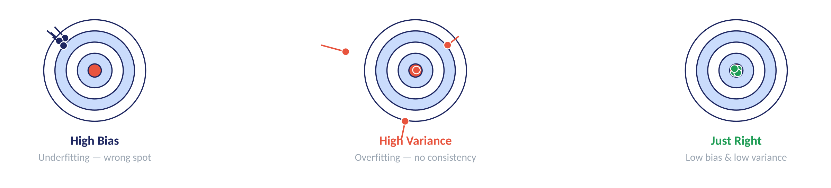
THE “WRONG ASSUMPTION” PROBLEM
Bias & the Goldilocks Zone
Bias is a wrong guess from the start. We want the “Just Right” model.
WHAT IS BIAS
THE TEACHER EXAMPLE
The model has a stubborn assumption (e.g. “Only height determines weight”). It aims for the wrong target entirely. High bias usually causes underfitting.
You assume “All teachers are mean.” Because of that bias, you never ask for help — and your grades drop.
THE GOAL Find the sweet spot between underfitting (too simple) and overfitting (too complex).
Underfitting = didn’t study enough. Overfitting = memorized the answer key. Bias = studied the wrong subject. Winner = understands the main ideas!
Notes:
Bias = a wrong starting assumption. The goal is the balance point between underfitting and overfitting.

